Slide 1

Crop Production Analysis
Abhijit Singh Batch – MIP-DA-04

Slide 2
Introduction
Agriculture in India has been the backbone of its economy for centuries, providing livelihoods to millions and serving as a critical component of the nation's food security. As India navigates through the complexities of modern agricultural challenges, there arises an increasing need for comprehensive analysis and informed decision-making to ensure sustainable farming practices and optimal resource allocation. In this pursuit, the internship project embarks on a journey to delve into the intricacies of Indian agriculture, leveraging data-driven insights to drive impactful change.
The project sets out with the ambition to conduct a thorough examination of Indian agriculture, focusing on district-wise and year-wise data encompassing various crops' cultivation, production, and yields. Through the lens of Power BI, the project aims to construct interactive visualizations that unravel trends, patterns, and disparities inherent in agricultural practices, thereby empowering stakeholders with actionable insights for informed decision-making.

Slide 3
Components of dataset
The dataset offers a comprehensive view of agricultural variables across various districts and years in India. It encompasses a wide range of data points related to crop cultivation, production quantities, and yields for numerous crops. Here's a breakdown of the key components of the dataset:
District and Year Information: Each entry in the dataset is associated with a specific district and year, providing the temporal and spatial context necessary for analysis.
Crop-specific Data: The dataset includes information on the cultivation, production, and yields of several major crops such as rice, wheat, sorghum, millets, pulses, oilseeds, sugarcane, and more. This information is provided in terms of area (in 1000 hectares), production (in 1000 tons), and yield (in kilograms per hectare) for each crop.
Seasonal Crop Data: Crop data is further segmented into kharif and rabi seasons, allowing for the exploration of seasonal patterns in crop cultivation and performance.
Crop Diversity: Apart from staple crops like rice and wheat, the dataset also covers the cultivation of other important crops including sorghum, millets (such as pearl millet and finger millet), maize, barley, chickpea, pigeonpea, minor pulses, groundnut, sesame, rapeseed and mustard, safflower, castor, linseed, sunflower, soybean, and various oilseeds.
Fruits and Vegetables: Additionally, the dataset includes information on the cultivation area of fruits, vegetables, and their combined cultivation area.
Other Agricultural Activities: Beyond crop cultivation, the dataset also provides insights into the cultivation area of potatoes, onions, and fodder, contributing to a comprehensive understanding of agricultural practices.

Slide 4
Components of dataset
The dataset offers a comprehensive view of agricultural variables across various districts and years in India. It encompasses a wide range of data points related to crop cultivation, production quantities, and yields for numerous crops. Here's a breakdown of the key components of the dataset:
District and Year Information: Each entry in the dataset is associated with a specific district and year, providing the temporal and spatial context necessary for analysis.
Crop-specific Data: The dataset includes information on the cultivation, production, and yields of several major crops such as rice, wheat, sorghum, millets, pulses, oilseeds, sugarcane, and more. This information is provided in terms of area (in 1000 hectares), production (in 1000 tons), and yield (in kilograms per hectare) for each crop.
Seasonal Crop Data: Crop data is further segmented into kharif and rabi seasons, allowing for the exploration of seasonal patterns in crop cultivation and performance.
Crop Diversity: Apart from staple crops like rice and wheat, the dataset also covers the cultivation of other important crops including sorghum, millets (such as pearl millet and finger millet), maize, barley, chickpea, pigeonpea, minor pulses, groundnut, sesame, rapeseed and mustard, safflower, castor, linseed, sunflower, soybean, and various oilseeds.
Fruits and Vegetables: Additionally, the dataset includes information on the cultivation area of fruits, vegetables, and their combined cultivation area.
Other Agricultural Activities: Beyond crop cultivation, the dataset also provides insights into the cultivation area of potatoes, onions, and fodder, contributing to a comprehensive understanding of agricultural practices.

Slide 5
Components of dataset
The dataset offers a comprehensive view of agricultural variables across various districts and years in India. It encompasses a wide range of data points related to crop cultivation, production quantities, and yields for numerous crops. Here's a breakdown of the key components of the dataset:
District and Year Information: Each entry in the dataset is associated with a specific district and year, providing the temporal and spatial context necessary for analysis.
Crop-specific Data: The dataset includes information on the cultivation, production, and yields of several major crops such as rice, wheat, sorghum, millets, pulses, oilseeds, sugarcane, and more. This information is provided in terms of area (in 1000 hectares), production (in 1000 tons), and yield (in kilograms per hectare) for each crop.
Seasonal Crop Data: Crop data is further segmented into kharif and rabi seasons, allowing for the exploration of seasonal patterns in crop cultivation and performance.
Crop Diversity: Apart from staple crops like rice and wheat, the dataset also covers the cultivation of other important crops including sorghum, millets (such as pearl millet and finger millet), maize, barley, chickpea, pigeonpea, minor pulses, groundnut, sesame, rapeseed and mustard, safflower, castor, linseed, sunflower, soybean, and various oilseeds.
Fruits and Vegetables: Additionally, the dataset includes information on the cultivation area of fruits, vegetables, and their combined cultivation area.
Other Agricultural Activities: Beyond crop cultivation, the dataset also provides insights into the cultivation area of potatoes, onions, and fodder, contributing to a comprehensive understanding of agricultural practices.

Slide 6
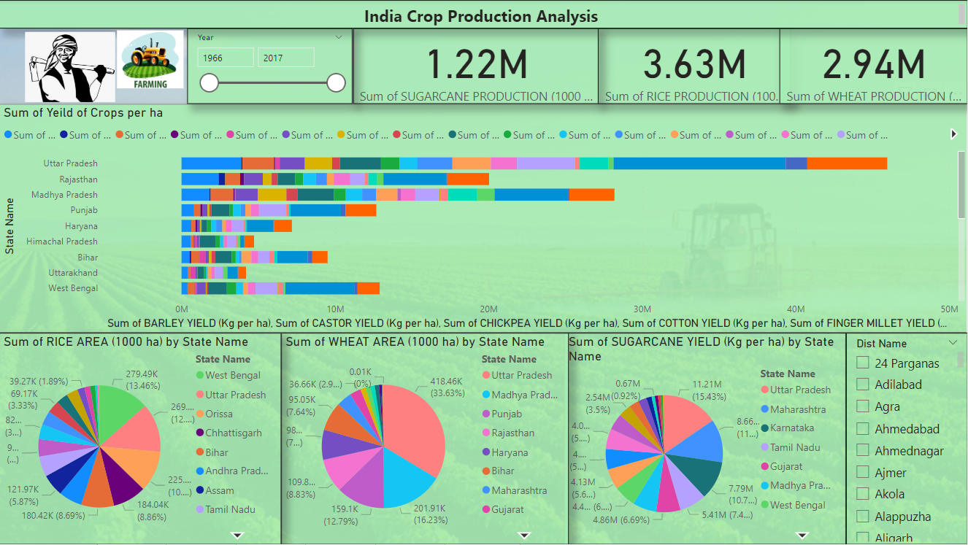
Crop Dashboard
The first Dashboard consists of information about the major crop production trends in India over the years. It shows statistics on crop production by state in India from 1966 to 2017. The dashboard includes:
Total production of sugarcane, rice, and wheat
Sum of yield per hectare of various crops
Sum of area under rice and wheat cultivation by state
Some of the key insights from the dashboard are that overall crop production in India has increased significantly, with rice being the most produced crop. Uttar Pradesh is the leading producer of sugarcane, rice and wheat. The yield per hectare has also increased across all the states.

Slide 7
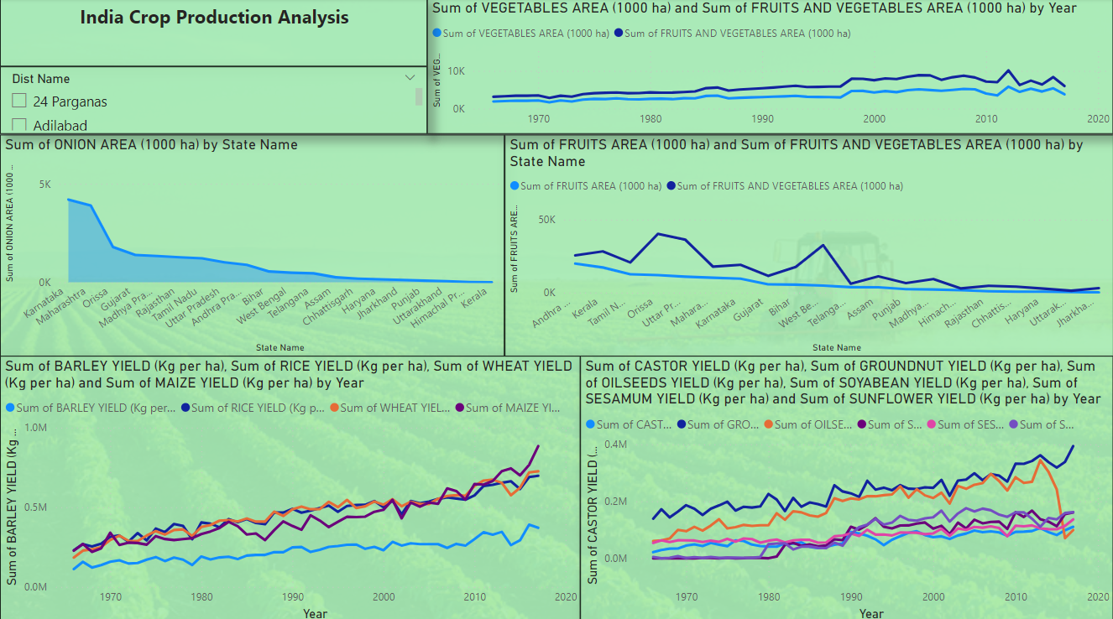
Crop Dashboard
Karnataka has highest production of onions per ha
Andhra Pradesh has the maximum area when it comes to production of vegetables
There was a sharp decline in the production of rice in early 2000’s.
There was a sharp decline in the production of oil seed after 2010.
Barley, wheat, castor, sunflower, soyabean and groundnut have seen a exponential growth in their production over the years.

Slide 8
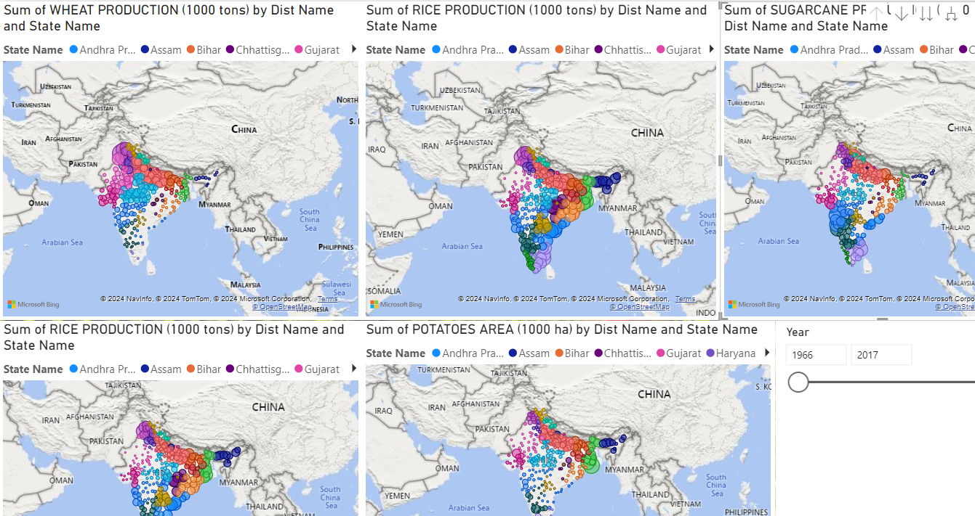
Crop Dashboard
The heat map shows the bubble representation of crops like wheat, rice , sugarcane and potato with their district wise value .
These values can be filtered based on the year of production to check the highest production of crop distict wise
Ferozpur (Punjab) district has the highest wheat production . Mednapur (WB) district produces highest amount of rice. Hooghly district in West Bengal produced highest amount of potatoes

Slide 9
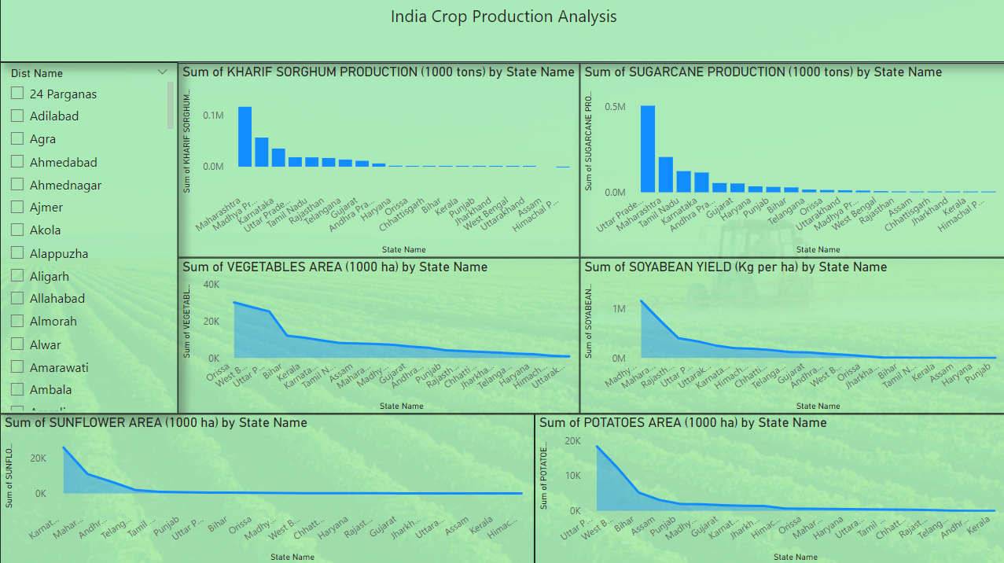
Crop Dashboard
Maharashtra has the highest production of kharif crops
Madhya Pradesh has the highest production of soyabean
Orrisa has highest production of vegetable followed closely by Westbengal,Bihar and UP
Uttar Pradesh is the highest producer of potato

Slide 10
Conclusion and recommendations
Overall Growth: Crop production has increased significantly since 1966, with some fluctuations.
Shifting Production: Rice remains the most produced crop, but there's a rise in production of barley, wheat, oilseeds, castor, sunflower, soybean, and groundnut.
Regional Variations: Uttar Pradesh is a leader in sugarcane, rice, and wheat production. Other states excel in specific crops: Maharashtra (kharif crops), Madhya Pradesh (soybean), Orissa & West Bengal (vegetables), Uttar Pradesh (potato).
District-Level Insights: The heatmap allows for analysis of high-production districts for key crops (wheat, rice, sugarcane, potato).
Recommendations for Policy Makers
Focus on Increasing Productivity: While overall production has grown, policies should encourage further yield improvement per hectare. This can involve promoting better seeds, irrigation methods, and agricultural practices.
Diversification: Support the growing trend towards diversified crops like barley, wheat, oilseeds, etc. This reduces dependence on a few staple crops and improves dietary diversity.
Regional Specialization: Invest in infrastructure and support for states with high potential in specific crops (e.g., soybean in Madhya Pradesh, vegetables in Orissa & West Bengal).
Data-Driven Decisions: Utilize the data from the dashboard and similar sources to identify areas needing improvement and tailor policies accordingly.
Focus on District-Level Performance: Analyze high-production districts to understand successful practices and replicate them in other areas (using the heatmap data).

